Slide 1
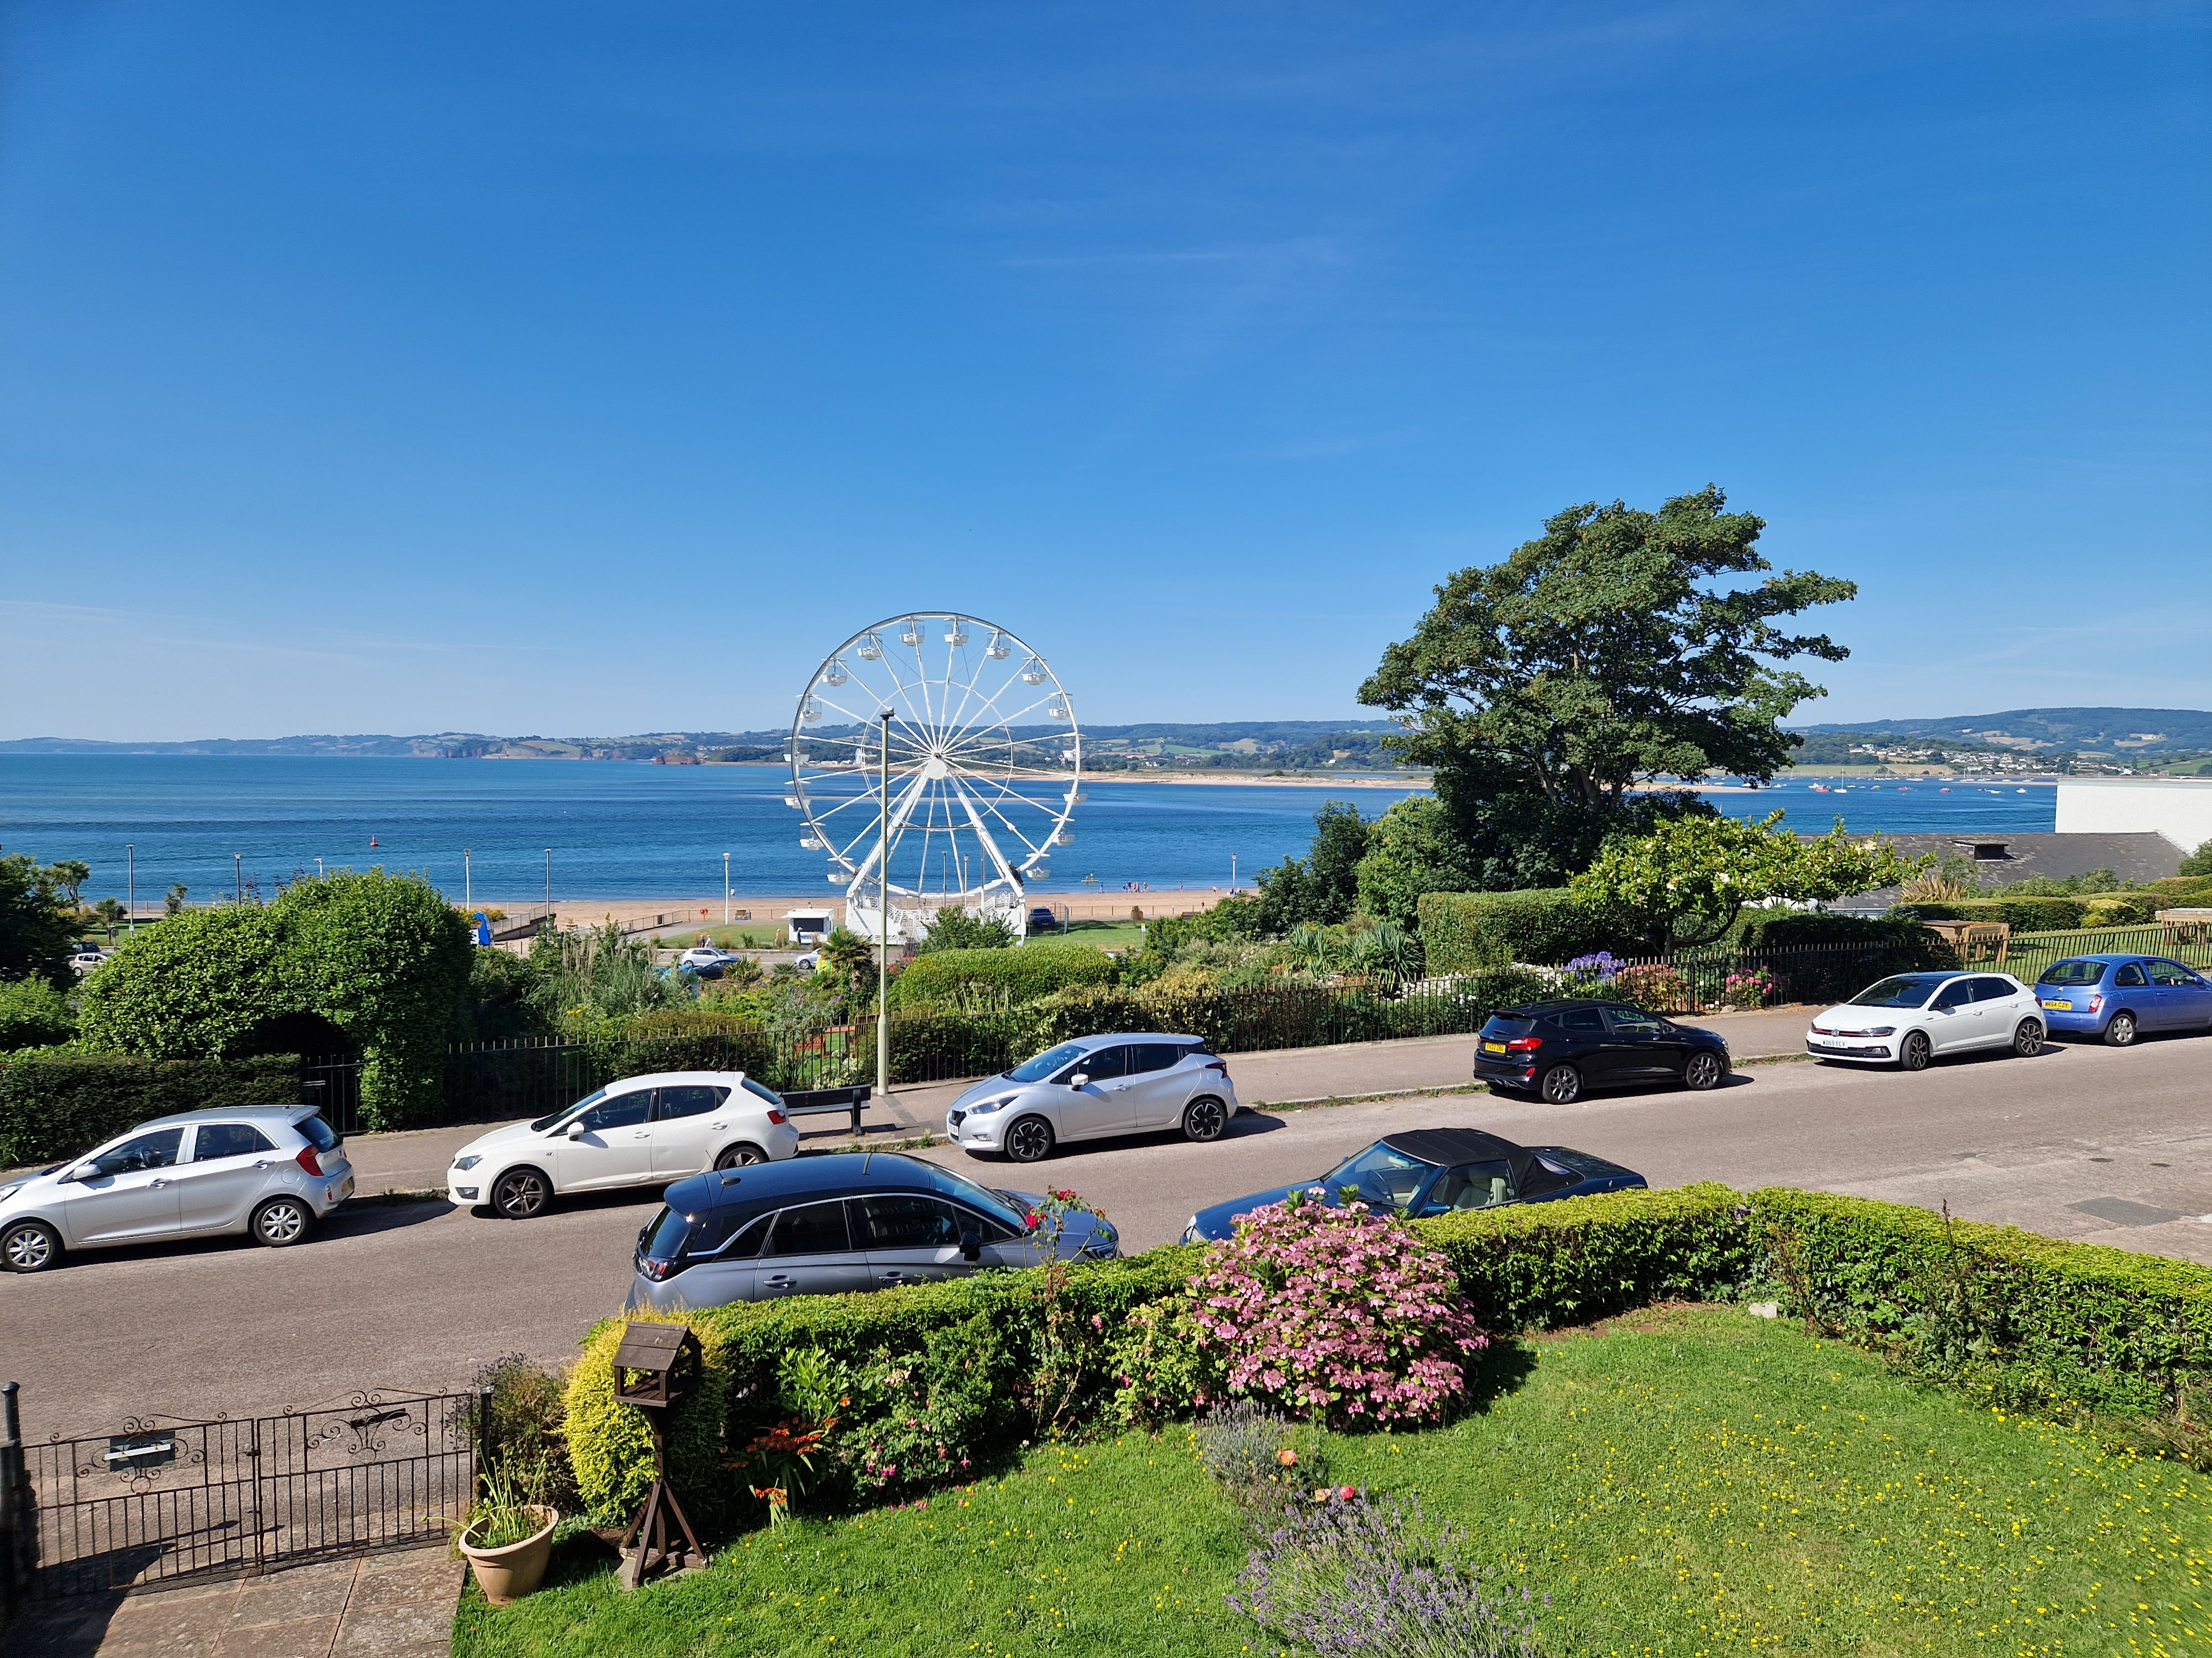
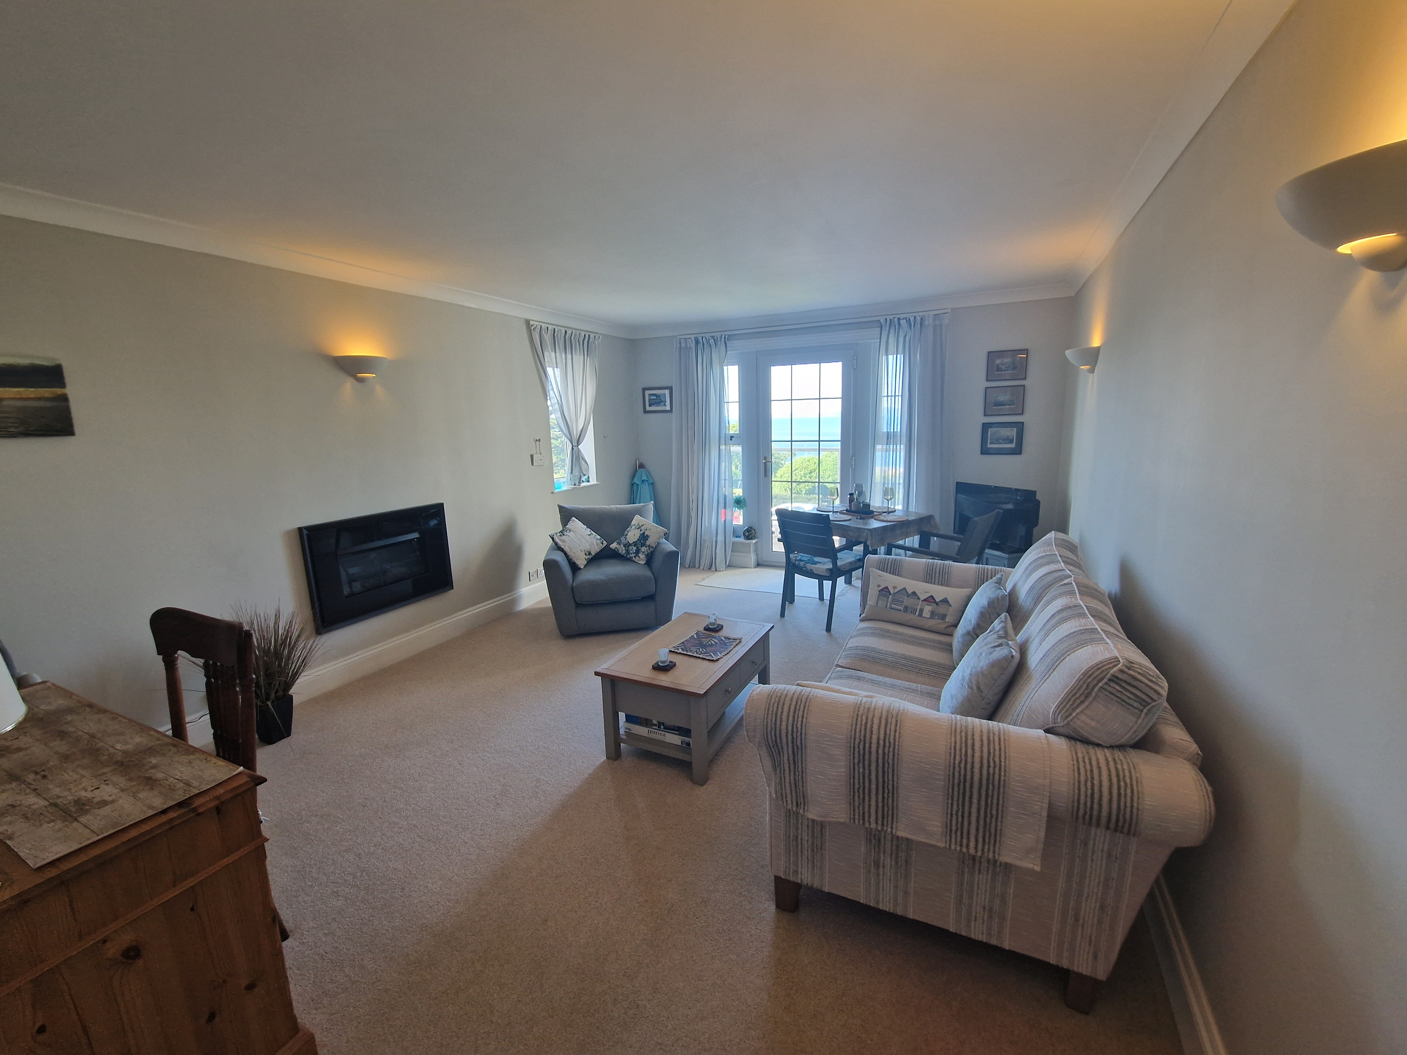
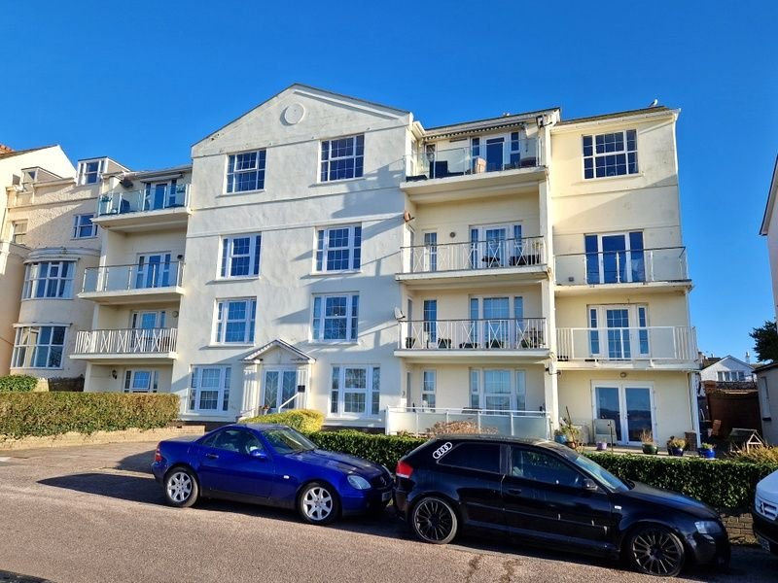
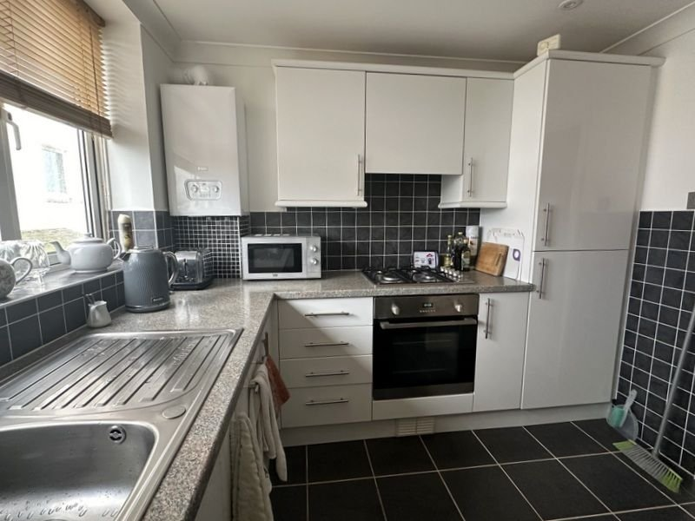
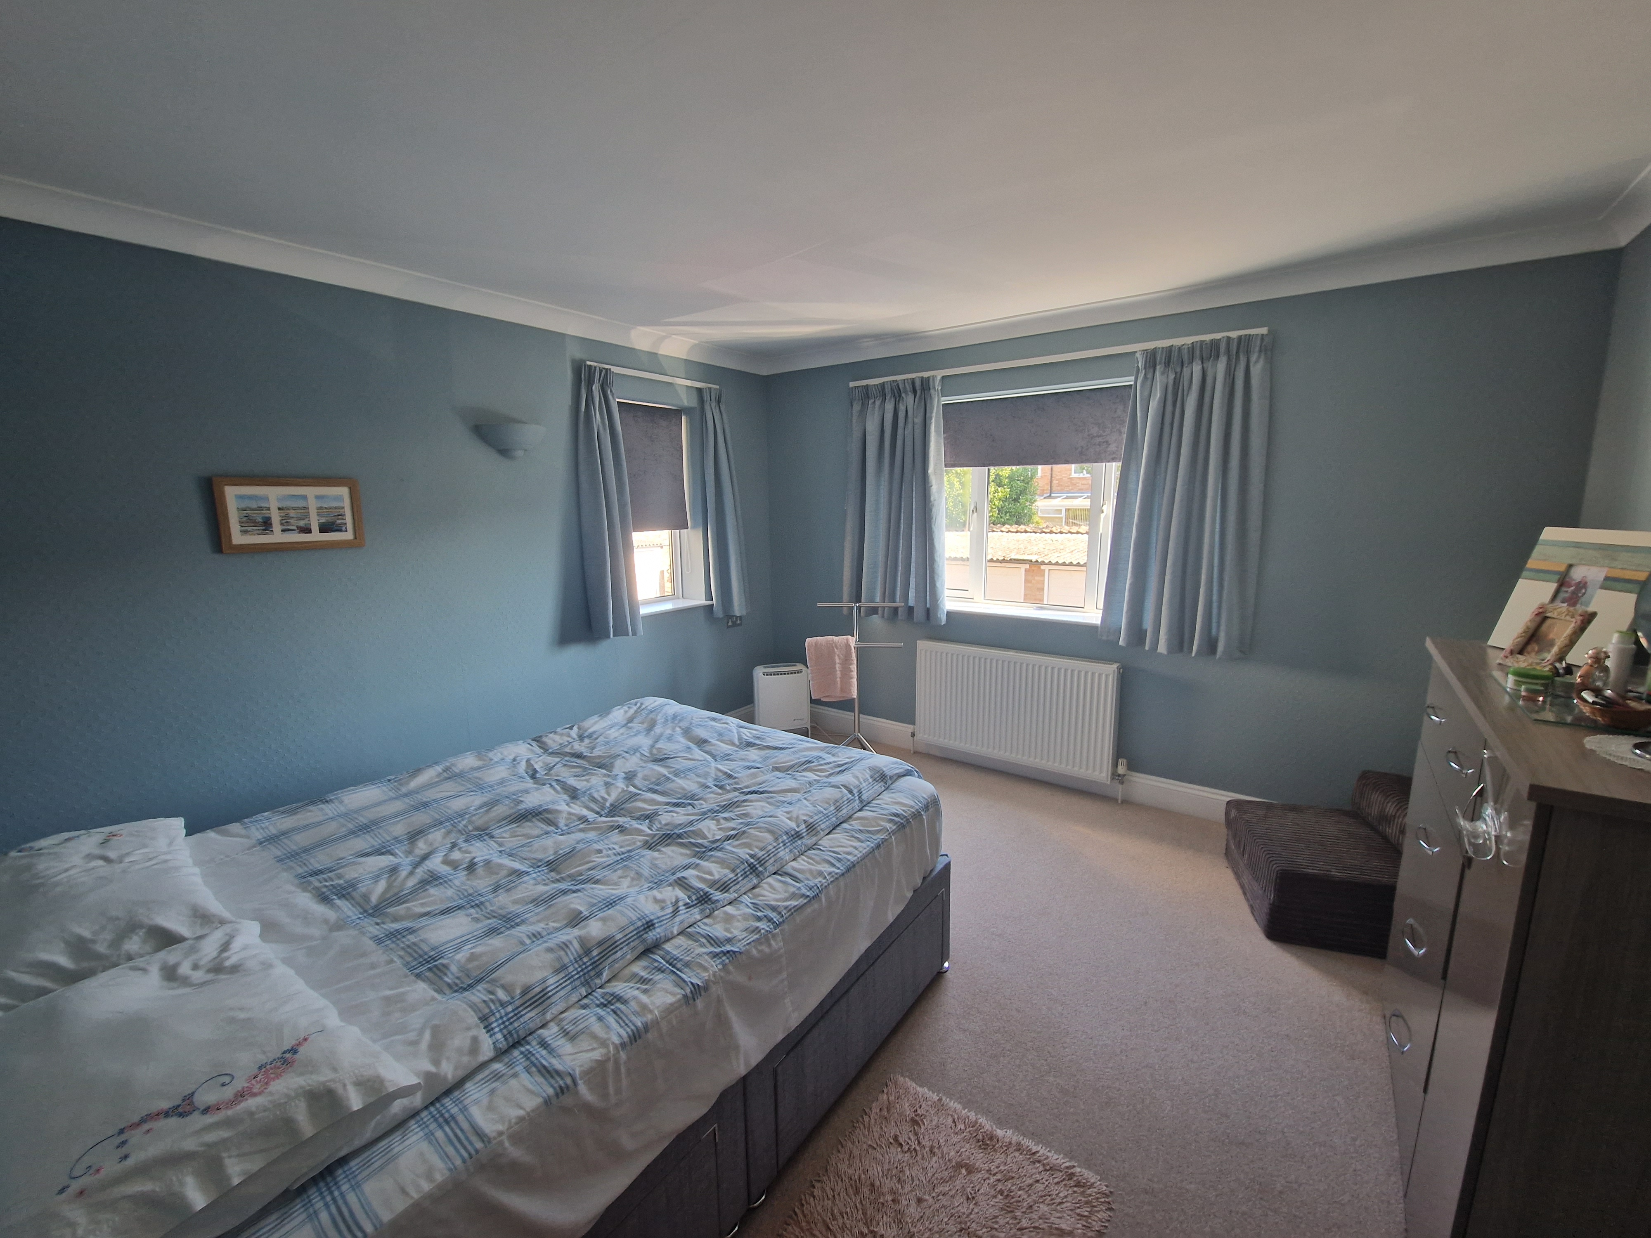
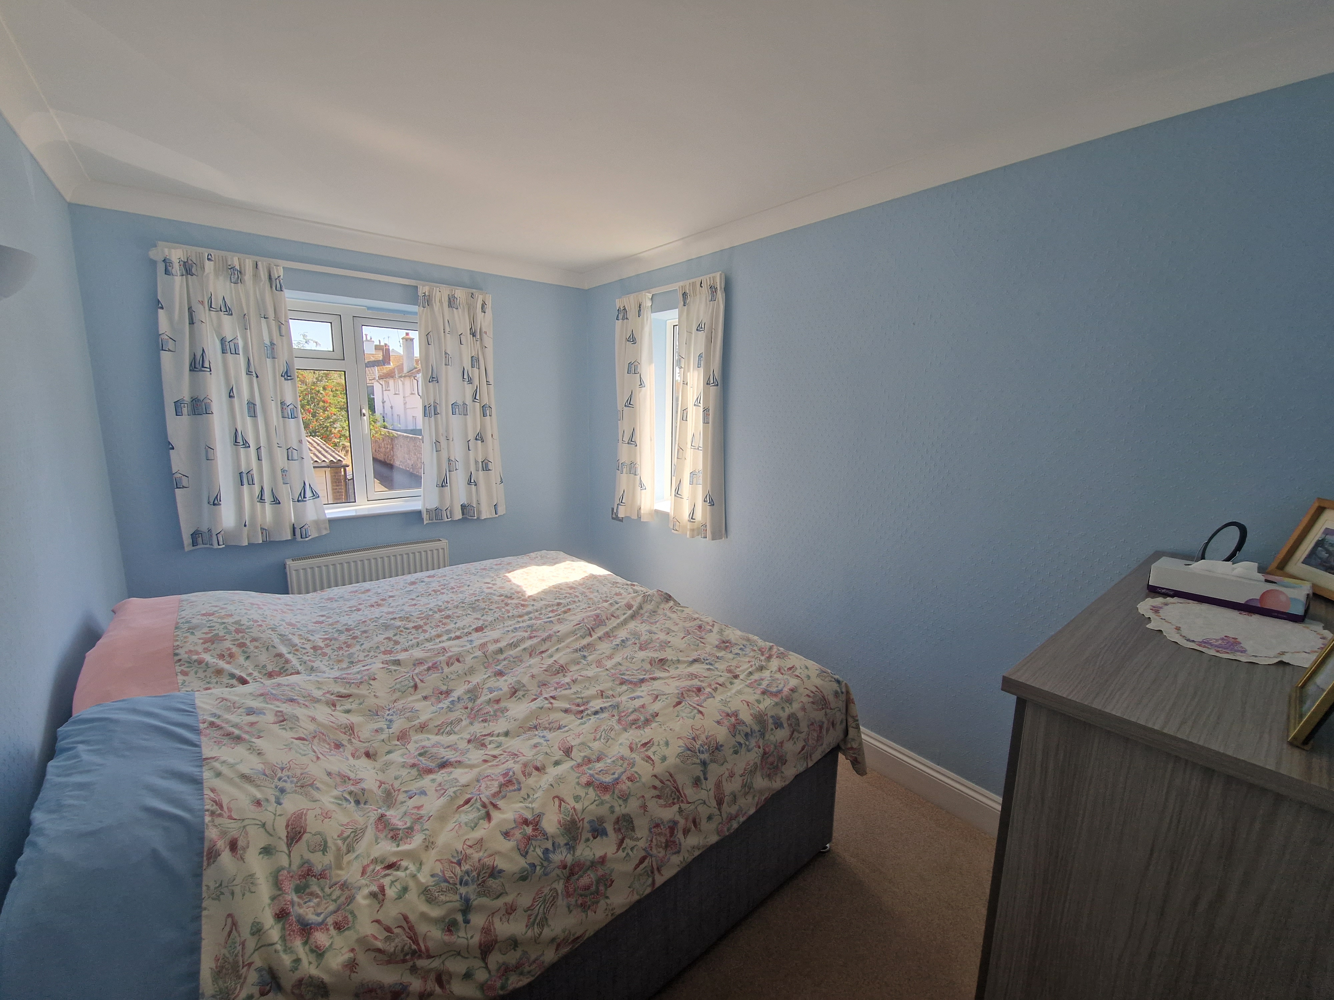
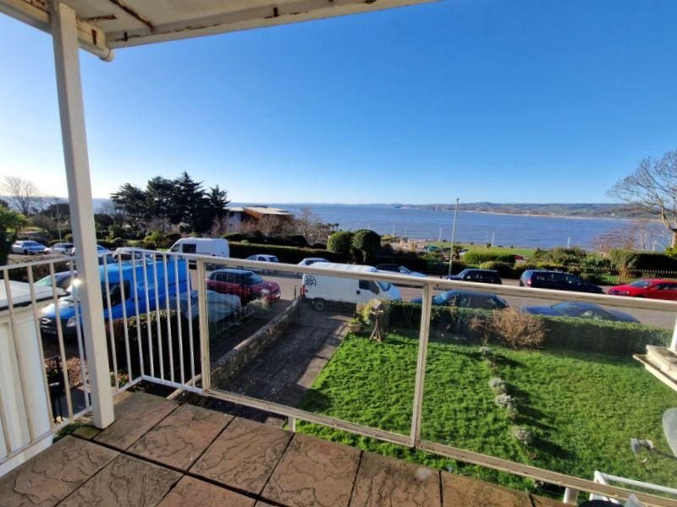
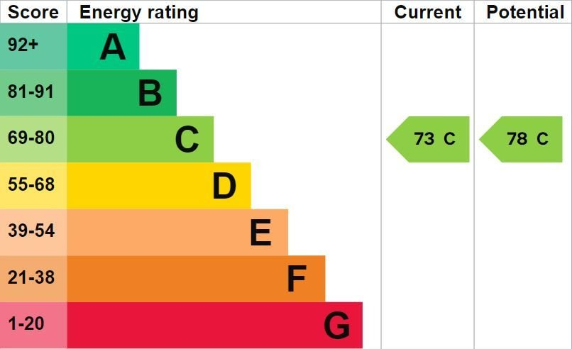
www.pennys.net
Flat 6, 7 Louisa Terrace, Exmouth, EX8 2AQ
OFFERS OVER £370,000
TENURE Share of Freehold
A Purpose Built First Floor Apartment Enjoying Uninterrupted Sea And Coastline Views
Bright Well Presented Accommodation • Lounge/Dining Room •
Cover Sun Balcony • Modern Fitted Kitchen • Two Double Bedrooms •
Stylish Modern Shower Room/WC & Separate Cloakroom/WC •
Garage In A Block To The Rear Of The Building Plus Parking Area • Gas Central Heating & Double Glazed Windows • Super Holiday Or Permanent Home • No Onward Chain •
Pennys Estate Agents Limited for themselves and for the vendor of this property whose agents they are give notice that:- (1) These particulars do not constitute any part of an offer or a contract. (2) All statements contained in these particulars are made without responsibility on the part of Pennys Estate Agents Limited. (3) None of the statements contained in these particulars are to be relied upon as a statement or representation of fact. (4) Any intending purchaser must satisfy himself/herself by inspection or otherwise as to the correctness of each of the statements contained in these particulars. (5) The vendor does not make or give and neither do Pennys Estate Agents Limited nor any person in their employment has any authority to make or give any representation or warranty whatever in relation to this property.
PENNYS ESTATE AGENTS
2 Rolle House, Rolle Street, Exmouth, Devon, EX8 2SN
Tel: 01395 264111 EMail: help@pennys.net

Slide 2
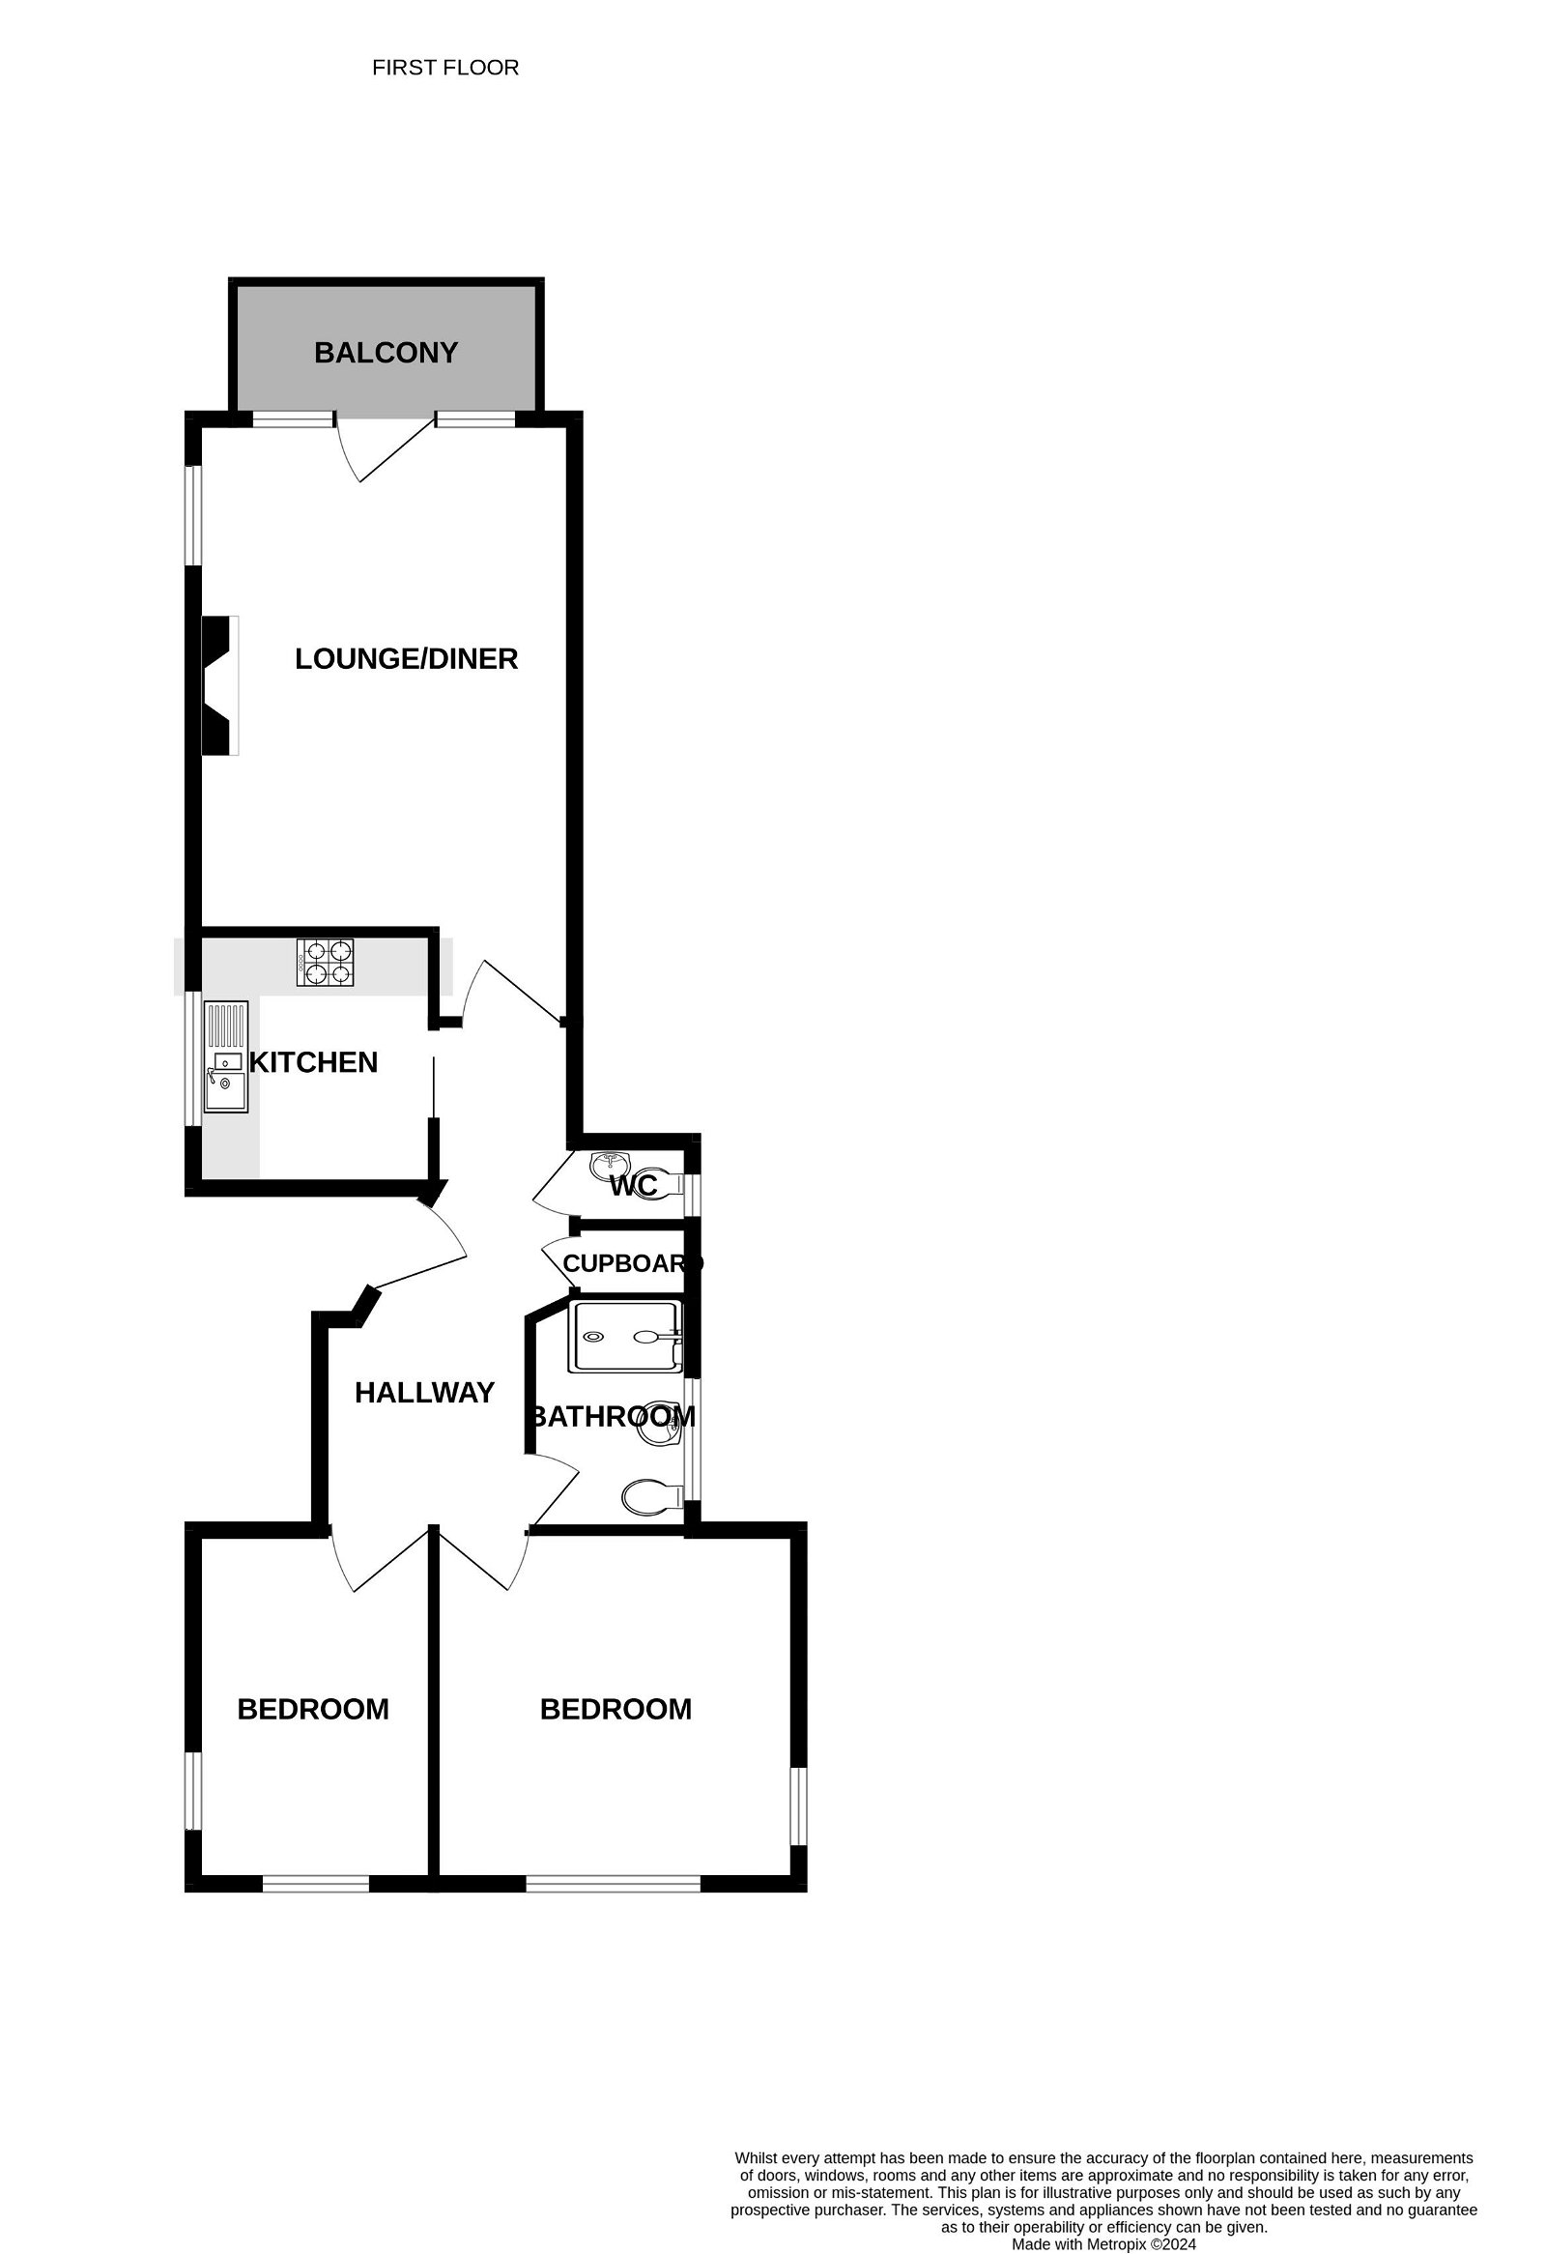
Flat 6, 7 Louisa Terrace, Exmouth, EX8 2AQ
THE ACCOMMODATION COMPRISES: The apartment is approached to the right-hand side of the building via an external staircase leading to a communal door which serves two apartments leading to a communal hallway with own private front door giving access to: RECEPTION HALL: With radiator; coved ceiling; smoke detector; wall lighting; cupboard housing electric meter and modern electric consumer unit. CLOAKROOM/WC: Stylish modern suite with space saver wash hand basin with cabinet beneath; WC with push button flush; splash back walls; double glazed window; coved ceiling. LOUNGE/DINING ROOM: 6.22m x 3.91m (20'5" x 12'10") maximum measurement into doorway recess. A bright and spacious room with double glazed window to the side aspect; double glazed windows and door giving access to the COVERED SUN BALCONY both of which enjoy stunning sea and coastline views; radiator; stylish wall mounted living flame fire; wall lighting; television point. KITCHEN/BREAKFAST ROOM: 2.77m x 2.72m (9'1" x 8'11") A modern fitted kitchen comprising range of patterned work top surfaces with tiled surrounds; inset single drainer sink unit with mixer tap; base cupboards; drawer units; space and plumbing for washing machine and integrated dishwasher beneath work surfaces; matching wall units; inset four ring gas hob with built-in oven below and extractor hood over; integrated fridge and freezer; wall mounted modern Baxi gas boiler serving domestic hot water and gas central heating; coved ceiling; smoke detector; tiled flooring; recess ceiling LED spotlighting; double glazed window to side aspect. BEDROOM ONE: 3.78m x 3.68m (12'5" x 12'1") A dual aspect room with double glazed window to the rear and side aspects; radiator; coved ceiling; wall lighting. BEDROOM TWO: 3.68m x 2.46m (12'1" x 8'1") Double glazed window to side and rear aspects; radiator; coved ceiling; wall lighting. SHOWER ROOM/WC: Stylishly refitted comprising of a double width shower cubicle with tiled walls and shower unit; wash hand basin with cabinet beneath; WC with dual push button flush; heated towel rail; attractive extensively tiled walls and flooring; double glazed window with pattern glass; recess ceiling LED spotlighting. OUTSIDE: The property is located in a highly desirable area enjoying uninterrupted sea and coastline views. The apartment benefits from a GARAGE with up and over door in a block to the rear of the building (vehicular access from Louisa Place) plus parking area for residents. There is a communal drying area. The property also benefits from the use of private communal gardens across the road to the front of the building which overlooks the sea. TENURE AND OUTGOINGS: We understand the property will be sold with a 999 year lease from 2024 (being created) and benefits from a 1/9th share of the freehold. The service charges are £310 per quarter.
FLOOR PLAN:

